Slide 1
Wind Turbine Fault Prediction and Maintenance Scheduling: The Use of Machine Learning Techniques
8th September, 2020
Author: Hanchao Chen
Supervisor: Matthew Piggott
Co-supervisor: James Percival

Slide 2
Contents
Wind Turbine Fault Prediction and Maintenance Scheduling
8th September, 2020
Background
Data Overview & Pre-processing
Regression Model
Binary Classiﬁcation Model
Multinomial Classiﬁcation Model
Conclusion and Future Work

Slide 3

Background
Wind Turbine Fault Prediction and Maintenance Scheduling
8th September, 2020
Wind energy: clean, free, renewable
Offshore wind farm
Difficulties:
high failure rate, the long downtime, and the low reliability
Operation and Maintenance (O&M):
25~30% production cost

Slide 4
How to reduce O&M cost
Wind Turbine Fault Prediction and Maintenance Scheduling
8th September, 2020
Accurate reliability assessment and fault prediction of wind turbines.
Remind the operators of necessary maintenance and repair of the power converter before a serious fault.
Supervisory Control and Data Acquisition (SCADA)
Record the evolution of different parameters of wind turbines.
Data-mining
Machine learning

Slide 5



Main Contributions
Wind Turbine Fault Prediction and Maintenance Scheduling
8th September, 2020
Three different machine learning based models for assessing wind turbines’ health status
New pre-processing method
A standard workﬂow

Slide 6
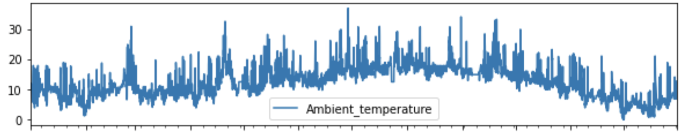
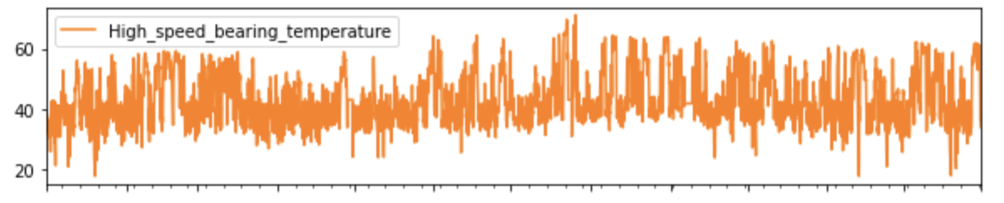
Data Overview
Wind Turbine Fault Prediction and Maintenance Scheduling
8th September, 2020
Status record
instanceID | ts_start | ts_end | duration | status | code | message | comment | contractCategory
BEI_WTG07 | 2019/1/2 12:32 | 2019/1/2 12:44 | 0:12:20 | stop | 94 | Stopped untwisting cables |  | Cable Unwind
BEI_WTG07 | 2019/1/8 7:02 | 2019/1/8 8:53 | 1:51:03 | stop | 16 | Control voltage drop |  | Unscheduled Maintenance - Electrical System
BEI_WTG07 | 2019/1/8 7:05 | 2019/1/8 8:54 | 1:48:39 | warning | 50001 | No communication |  | <undefined>
BEI_WTG07 | 2019/1/8 8:56 | 2019/1/8 9:17 | 0:20:41 | stop | 51 | Low lower voltage exceeded | Turbine surrendered by Duncan Mcneil AWP 008, 08/01 further investigation required. | Unscheduled Maintenance - Electrical System
Parameters record

Slide 7
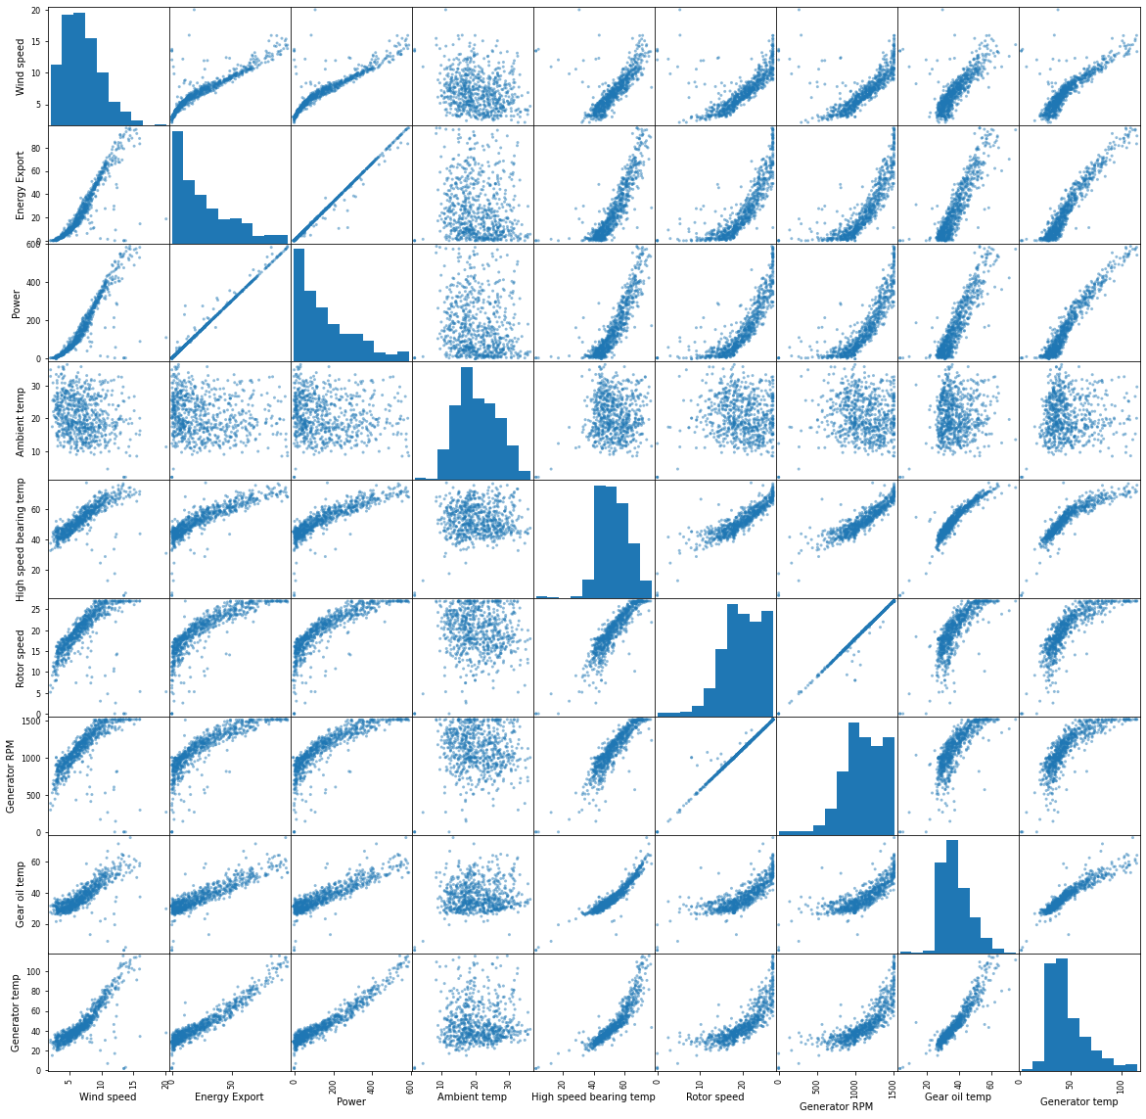
Data Pre-processing
Visualization & Variables selection
Density plot (diagonal)
Correlation plot (other)

Slide 8
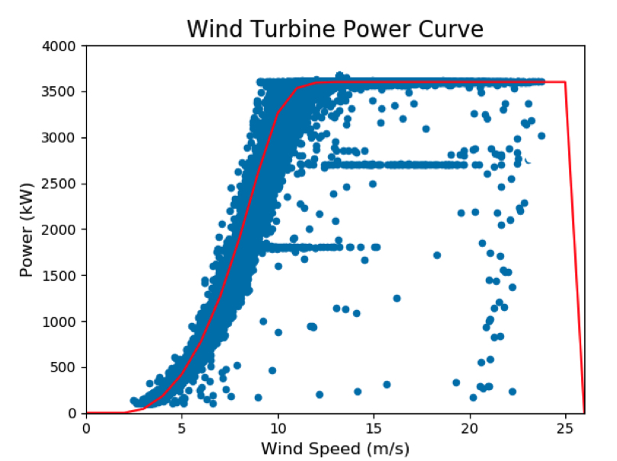
Data Pre-processing
Wind Turbine Fault Prediction and Maintenance Scheduling
8th September, 2020
Useless value removal
Missing values
Low output power values
Curtailment values
outliers
W. Soﬁa. Condition-Based Maintenance of Oﬀshore Wind Farms: The Use of SCADA Data in Normal Behavior Modelling. Master’s thesis, Imperial College London, 2018.

Slide 9
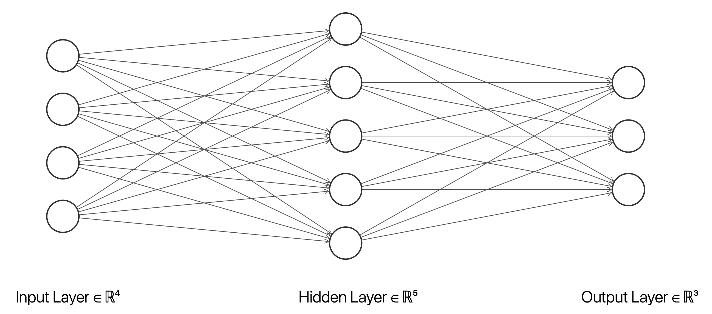

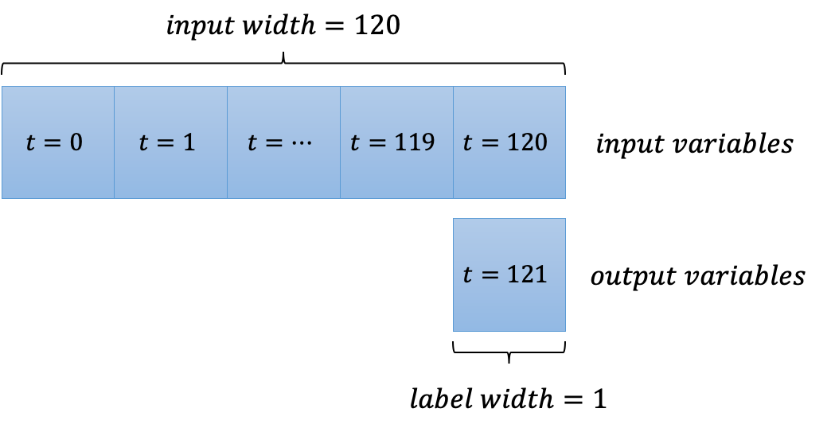
Regression Model
ANN vs. LSTM
(Long Short-Term Memory)

Slide 10
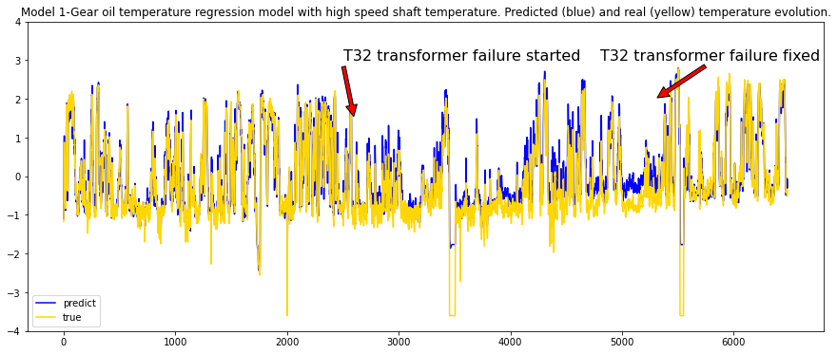
Regression Model
Wind Turbine Fault Prediction and Maintenance Scheduling
8th September, 2020
Abnormal evolution
Prediction vs. Real
deviation

Slide 11
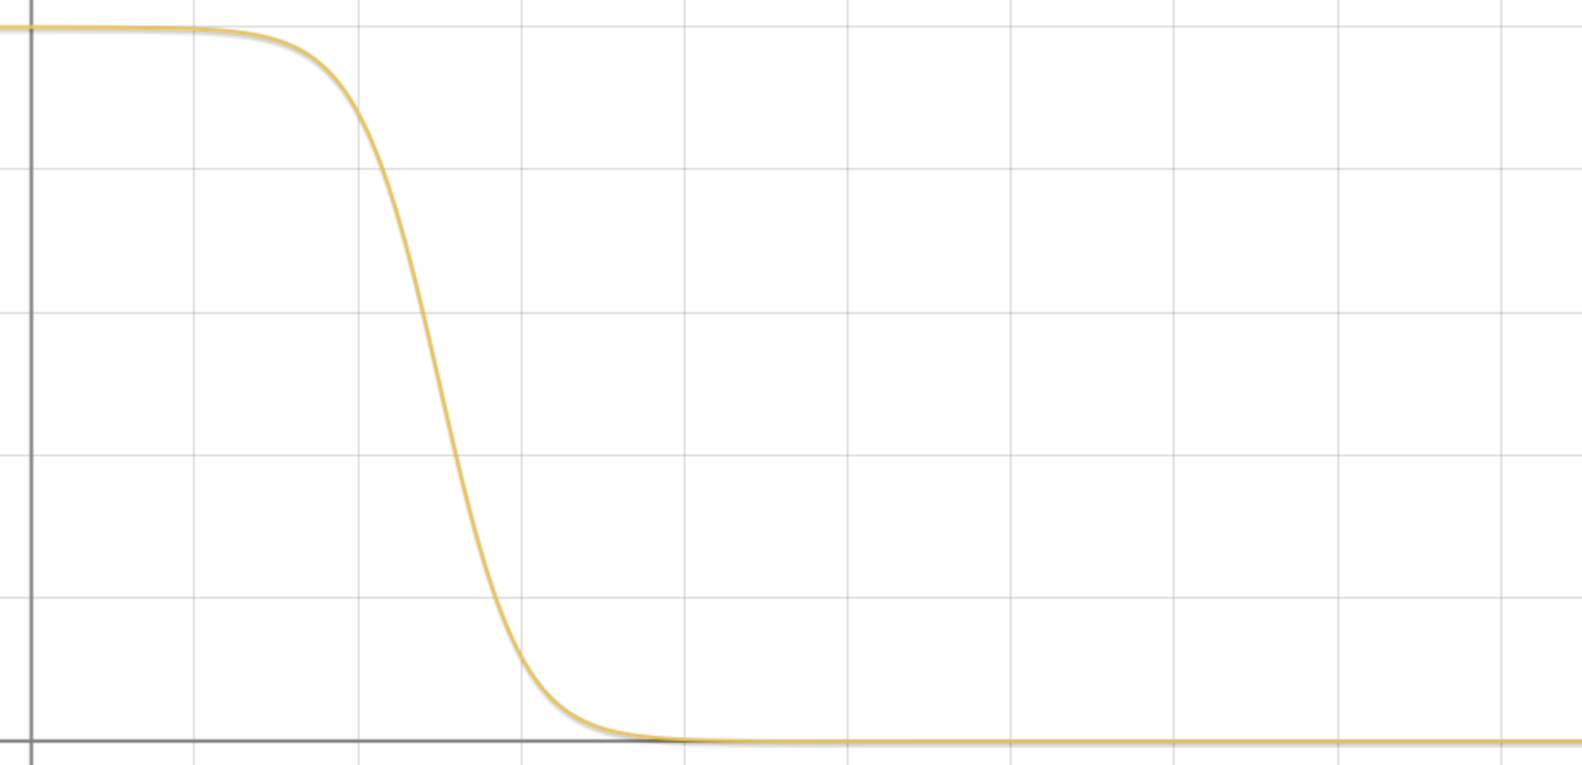
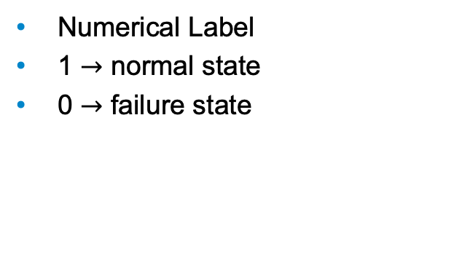
Binary Classification Model
Wind Turbine Fault Prediction and Maintenance Scheduling
8th September, 2020
Normal state
1.0
Numerical Label
1 $→$ normal state
0 $→$ failure state
Label
Early state of failure
0
Failure state
evolution

Slide 12
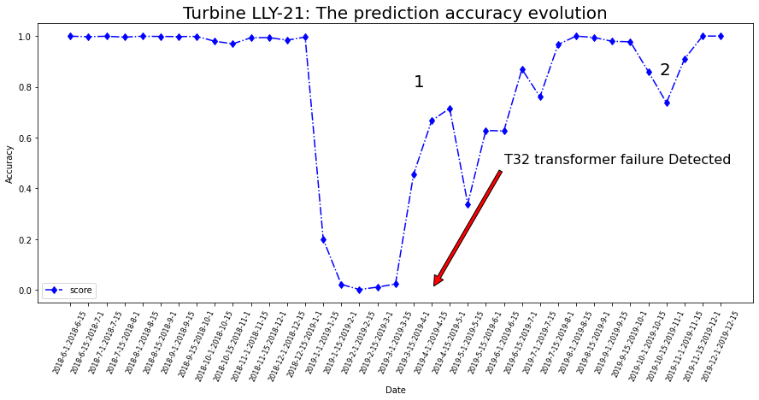
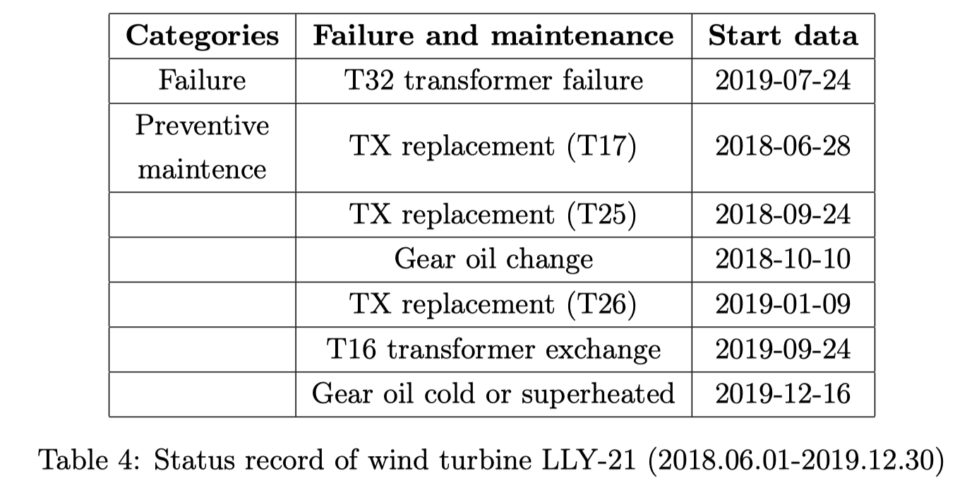
Binary Classification Model
Wind Turbine Fault Prediction and Maintenance Scheduling
8th September, 2020
Test on LLY-21

Slide 13
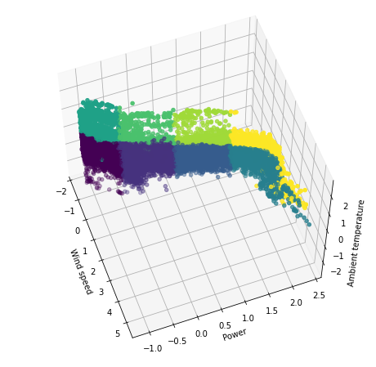
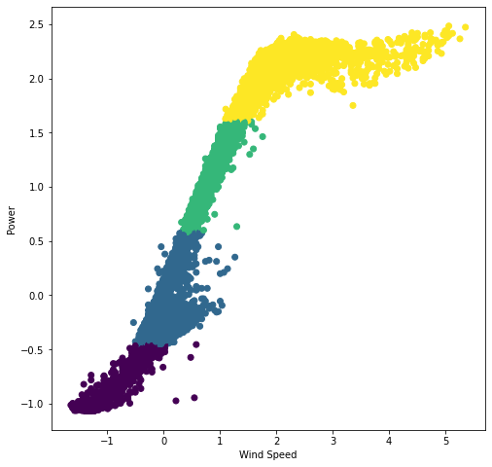
Multinomial Classiﬁcation Model
Wind Turbine Fault Prediction and Maintenance Scheduling
8th September, 2020
3D view
New data pre-processing strategy
Active variables:
Passive variables:
2D view
ambient temperature, power, wind speed
gear oil temperature, generator RPM,
generator temperature,
high speed bearing temperature…

Slide 14
Multinomial Classiﬁcation Model
Wind Turbine Fault Prediction and Maintenance Scheduling
8th September, 2020
Active variables
decide
Operating state (clusters)
Single data point
Passive variables
predict
High accuracy
Normal
Belong to
Low accuracy
Failure

Slide 15
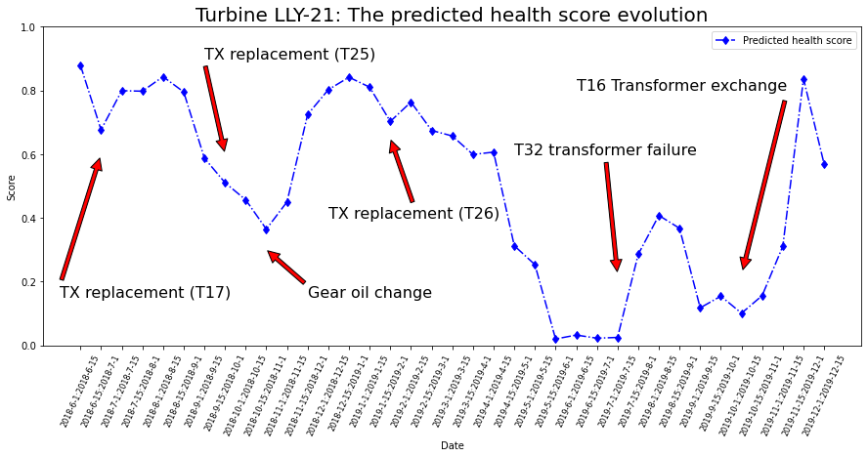
Multinomial Classiﬁcation Model
Wind Turbine Fault Prediction and Maintenance Scheduling
8th September, 2020
Test on LLY-21

Slide 16
Conclusion
Wind Turbine Fault Prediction and Maintenance Scheduling
8th September, 2020
Future Work
Three machine learning based models, three aspects.
A new pre-processing method (cluster method)
A standard workﬂow
Combine LSTM with Multinomial Classiﬁcation Model
Revise the cluster method
Methods of processing time series
Efficient, great potential
“off line” training, “on line” prediction

Slide 17
THANKS
Wind Turbine Fault Prediction and Maintenance Scheduling
8th September, 2020

